Slide 1

网关冗余协议

Slide 2
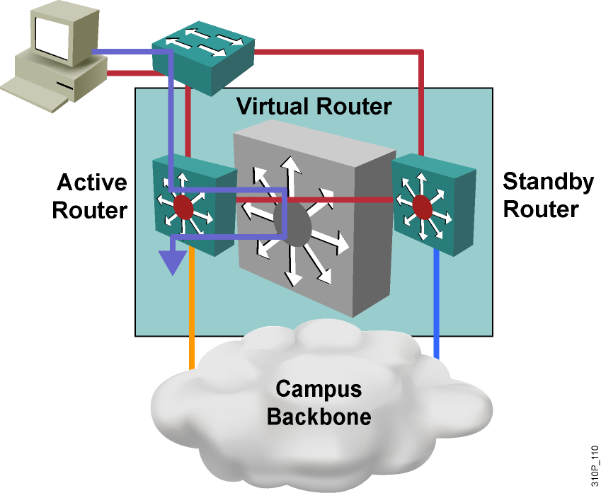
HSRP（Host Stanby Route Protocol）
&HSRP定义了路由器的备份组.
&备份组是一组参与HSRP的路由器,它们一起来模拟一台虚拟的路由.
&HSRP备用组包含了下列实体：
①一台活跃路由器.
②一台备用路由器.
③一台虚拟路由器.（虚拟IP和虚拟MAC）
④其他HSRP成员路由器.
（处于监听状态的路由器,它们监听Hello包,但不响应.这些路由器对发送给其他IP地址的数据包不进行转发,因为它们不是活跃的路由器,所以它不转发发送给虚拟路由器的数据包!）
&活跃路由器备份路由器发送Hello包是通过组播地址224.0.0.2.采用UDP=1985端口.
Standby group: The set of routers participating in HSRP that jointly
（共同的）emulate a virtual router
Notes:
路由器的集合,共同参与HSRP模拟一个虚拟的路由器
Slide 1 of 2
Purpose: This introduces the concept of HSRP.
Emphasize:
HSRP is designed for a LAN segment where multiple routers are present and where the end user stations use only a static default gateway IP address.
A set of routers on a LAN segment are designated as members of a virtual standby group. This standby group contains a virtual router configured with a unique IP and MAC address.
The virtual router does not physically exist but represents the common target for two or more routers that are configured to provide backup to each other.
The routers manage this virtual gateway address, communicating among themselves to determine which router is responsible for forwarding traffic sent to the virtual IP address.
When an active HSRP router receives an ARP request for a node that is not on the local LAN, the router replies with the MAC address of the virtual router.
Stress that connectivity must be guaranteed between the router ports. If connectivity between the router ports fails, then both routers assume the virtual IP address and advertise reachability to the rest of the network.
Transition: Following continues the discussion of HSRP.

Slide 3
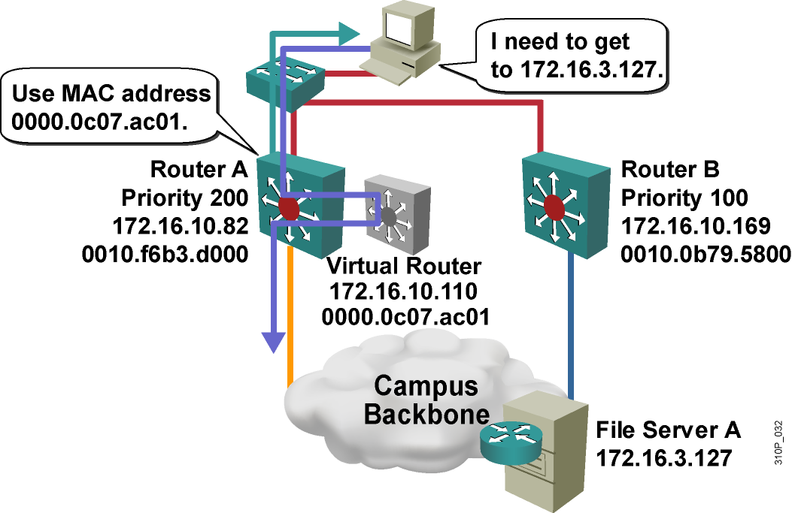
The Active Router
活跃路由器能够以虚拟路由器的MAC地址响应客户端发送的ARP请求
Notes:
Purpose: This slide discusses the how HSRP designates an Active Router.
Emphasize:
One router in each group is elected to be the active router.
The election process occurs through the sending and receiving of Hello messages. The Hello message contain a priority level for the sending router.
The router with the highest standby priority in the group becomes the active router.
If the priority level is the same for each router in the group, the first router to come up and obtain the virtual router IP address becomes the active router.
The active router is responsible for forwarding the packets sent to the virtual router.
Although multiple routers can exist in an HSRP group, only the active router forwards the packets sent to the virtual router.
The active routers accepting or forwarding such traffic when the router leaves the Active state.
Transition: Following discusses how to locate the virtual router MAC address.

Slide 4
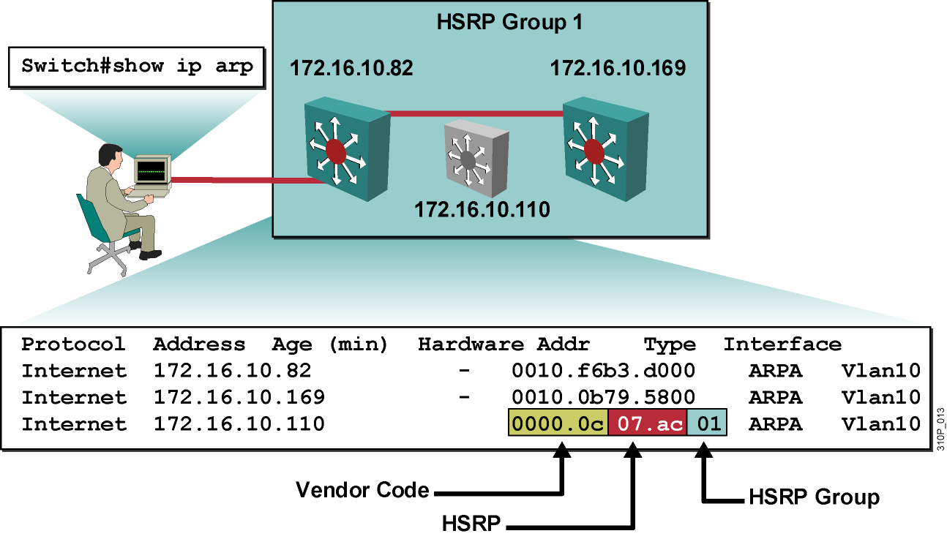
The Virtual Router MAC Address
Notes:
Purpose: This slide discusses the show ip arp command.
Emphasize:
ARP establishes correspondences between network addresses, such as an IP address and hardware Ethernet address. Each router maintains a table of resolved addresses. The router checks this ARP cache before attempting to contact a device to determine if the address has already been resolved.
The IP address and corresponding MAC address of the virtual router is maintained in the ARP table of each router in an HSRP standby group.
To display the Address Resolution Protocol (ARP) cache on a router, enter the following command in privileged EXEC mode.
Router#show ip arp
Point out the following items in the graphic display
The virtual router IP address is 172.16.10.110.
The virtual router MAC address is the well know MAC address 0000.0c07.AC and the HSRP group identifier is 0a.
The interface is Vlan10 on an RSM.
Transition: Following discusses HSRP maintains an active router.

Slide 5
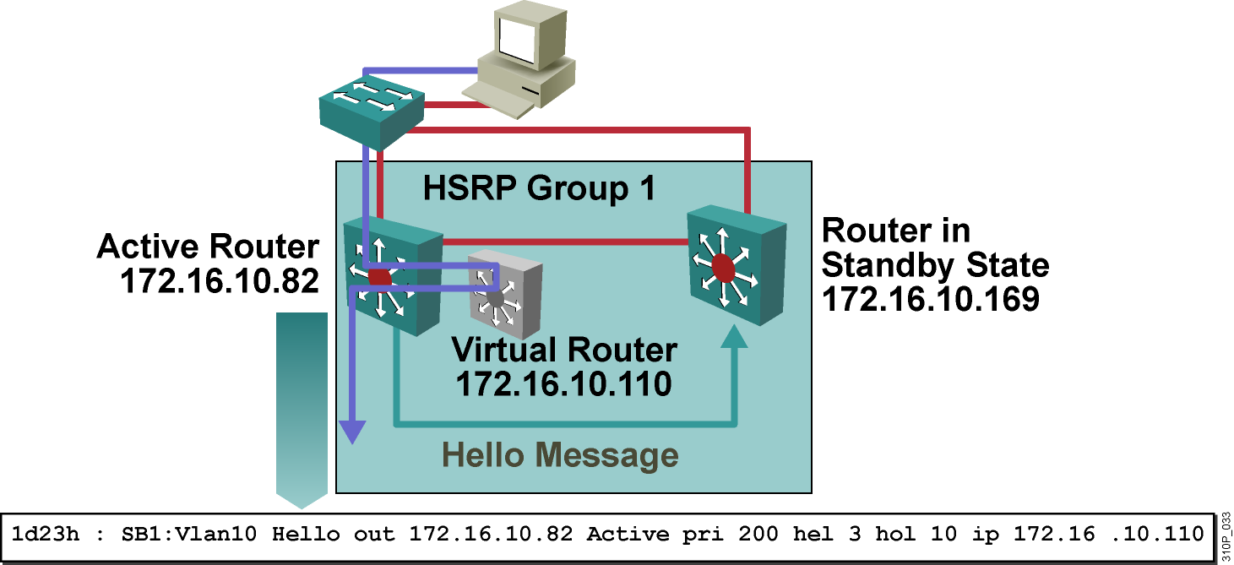
The Standby Router
The standby router listens for periodic hello messages on 224.0.0.2
Notes:
Purpose: This slide discusses how the active and standby routers interact.
Emphasize:
The active router broadcasts periodic hello messages while the other HSRP routers listen for such messages.
Another router in the group is elected as the standby router. The standby router monitors operational status of the HSRP group
The role of the standby router is to assumes the role of the active router if the current active router should fail.
Transition: Following continues the discussion of the standby router.

Slide 6
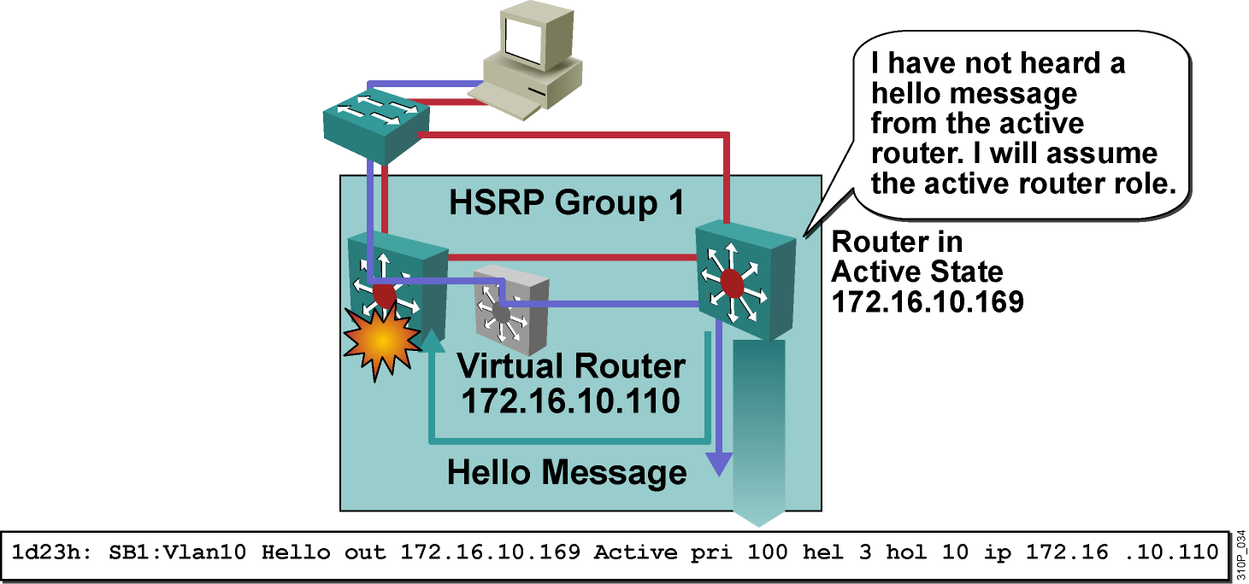
Active and Standby Router Interaction
Notes:
Interaction 交互
Purpose: This slide discusses how the standby router assume the active router role.
Emphasize:
The standby router assumes packet-forwarding responsibility when the principal router becomes inoperable.
The standby router determines the active router is no longer operational when the standby router fails to see a Hello message from the active router within a determined amount of time.
This mechanism remains transparent to the attached hosts.
Because the new active router assumes both the IP and MAC addresses of the virtual router, the end stations see no disruption in service. The end user stations continue to send packets to the virtual router MAC address and the new active router delivers those packets.
Transition: Following discusses router membership in multiple HSRP groups.

Slide 7
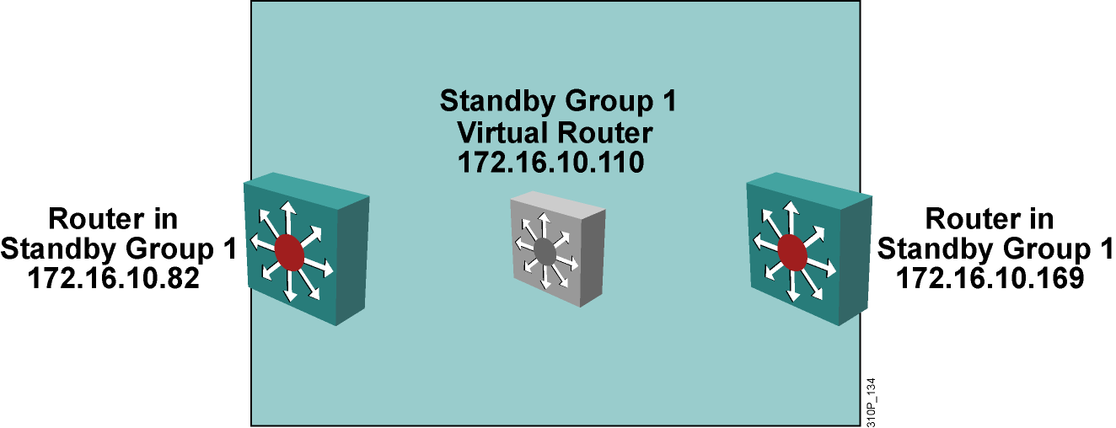
HSRP States
An HSRP router can be in one of six different states:
Initial
Learn→no virtual ip
Listen
Speak
Standby
Active

Slide 8
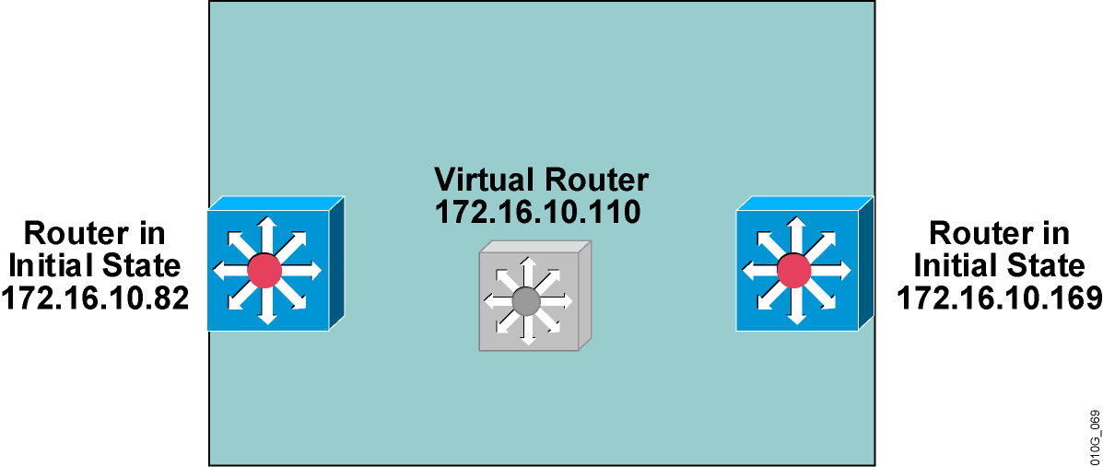
HSRP Initial State
  All routers begin in the initial state, when HSRP is not running.
Notes:
Purpose: This slide discusses the Initial state of an HSRP router.
Emphasize:
This slide illustrates the text in the Student Guide. This slide does not appear in the Student Guide.
All routers begin in the initial state.
This state is the starting state and indicates that HSRP is not running.
This state is entered via a configuration change, such as when HSRP is disabled on an interface; or when an HSRP-enabled interface is first brought up, such as when the no shutdown command is issued.
Transition: Following continues the discussion of HSRP states.

Slide 9
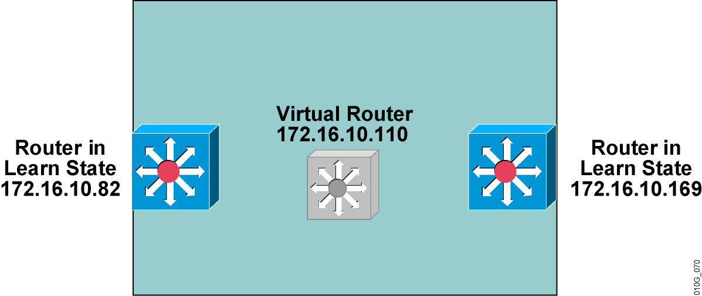
HSRP Learn State
  Router does not know the virtual router IP address.
  Router has not received a hello message from an active router.
Notes:
Purpose: This slide discusses the Learn state of an HSRP router.
Emphasize:
In the learn state, the router is still waiting to hear from the active router.
The router has not yet seen a Hello message from an active router.
The router does not know the IP address of the virtual router.
Example:
00:05:36:%STANDBY-6-STATECHANGE: Standby: 47: Vlan1 state Init->Listen
Transition: Following continues the discussion of HSRP states.

Slide 10
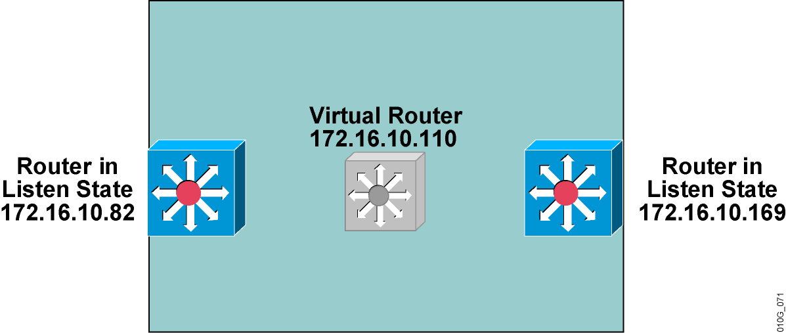
HSRP Listen State
  Neither the active nor the standby router receives a hello message (if any).
  The router in the listen state knows the virtual router IP address.
Notes:
Listen： 目的是为了确认组中是否存在Active/Standby路由器，如果存在，则停留在Listen状态，不存在，则进入speak状态。
Purpose: This slide discusses the Listen state of an HSRP router.
Emphasize:
In the listen state, the router knows the virtual IP address, but is neither the active router nor the standby router.
The router listens for Hello messages from those routers.
If the router in the Listen state does not detect a Hello message from either the Active or the Standby router in a determined amount of time, the router transitions out of the Listen state and begins to vie for the active router role.
Transition: Following continues the discussion of HSRP states.

Slide 11
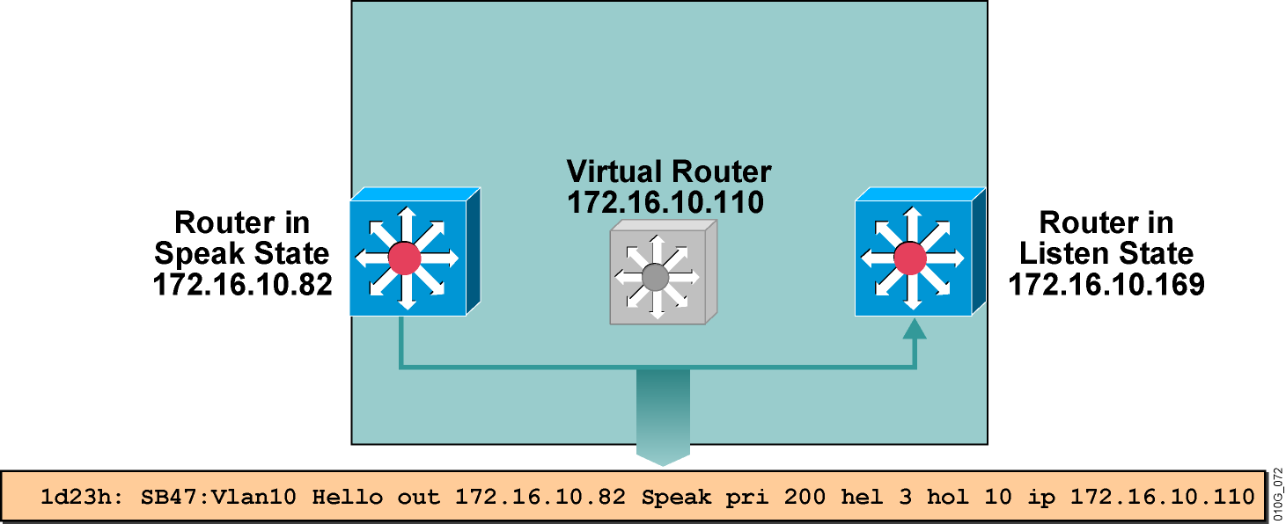
HSRP Speak State
  Knows the virtual router IP address.
  Sends periodic Hello messages.
  Participates in the election of the active and standby router.
Notes:
Purpose: This slide discusses the Speak state of an HSRP router.
Emphasize:
In the Speak state, the router sends periodic Hello messages and is actively participating in the election of the active and/or standby router.
The router must know the IP address of the virtual router prior to entering the Speak state.
Example:
0:05:36:%LINEPROTO-5-UPDOWN: Line protocol on Interface Vlan1, changed state to up
00:05:38:%LINK-3-UPDOWN: Interface Vlan1, changed state to up
00:05:46:%STANDBY-6-STATECHANGE:Standby: 47: Vlan1 state Listen-> Speak
00:05:46:SB47:Vlan1 Hello out 172.16.10.82 Speak pri 200 hel 3 hol 10 ip 172.16.10.110
00:05:47:SB47:Vlan1 Hello in 172.16.10.169 Speak pri 100 hel 3 hol 10 ip 172.16.10.110
Transition: Following continues the discussion of HSRP states.

Slide 12
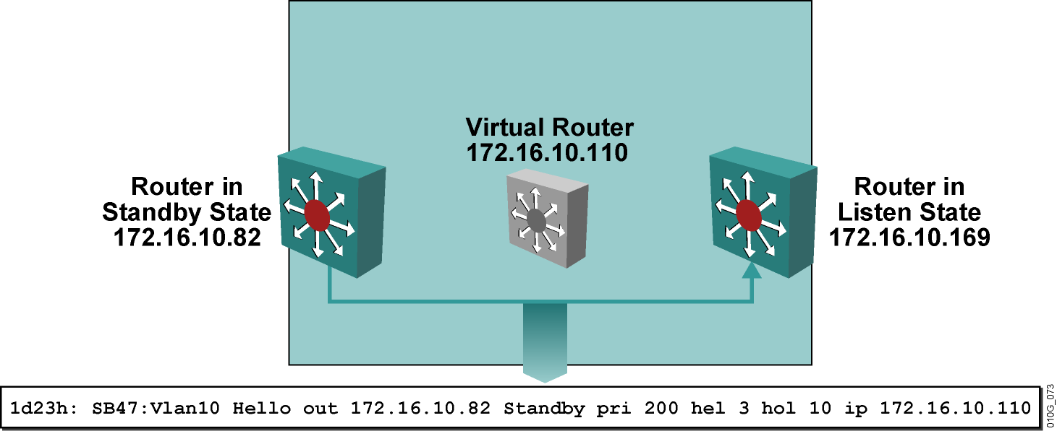
HSRP Standby State
  A router in the standby state:
  Is a candidate for active router
  Sends hello messages
  Knows the virtual router IP address
Notes:
Purpose: This slide discusses the Standby state of an HSRP router.
Emphasize:
In the Standby state, the router is a candidate to become the next active router.
The router in Standby state sends periodic Hello messages.
Excluding transient conditions, there can be only one standby router in the HSRP group.
Example:
00:05:56:%STANDBY-6-STATECHANGE:Standby:47:Vlan1 state Speak->Standby
00:05:56:SB47:Vlan1 Hello out 172.16.10.82 Standby pri200 hel3 hol10 ip 172.16.10.110
Transition: Following concludes the discussion of HSRP states.

Slide 13
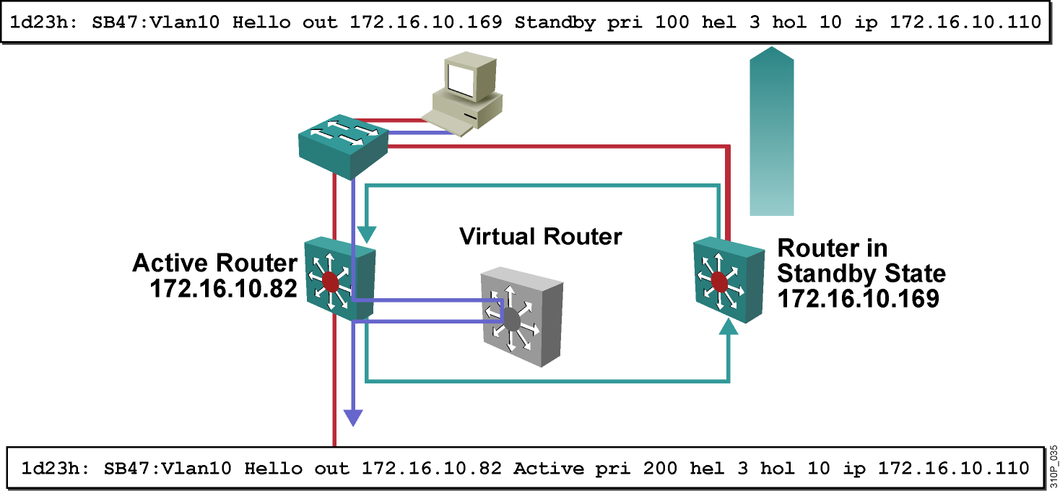
HSRP Active State
  A router in the active state:
  Assumes the active forwarding of packets for the virtual router
  Sends hello messages
  Knows the virtual router IP address
Notes:
Purpose: This slide discusses the Active state of an HSRP router.
Emphasize:
In the Active state, the router is currently forwarding packets that are sent to the virtual MAC address of the group.
The active router sends periodic Hello messages.
The router in the Active state knows the IP address of the virtual router.
The router in the Active state is the router with the highest priority in the group.
In the case, where each router has the same level of priority, the Active router is the first router to send out a qualified Hello message.
The must be one active router in the HSRP group.
Example:
00:05:56:%STANDBY-6-STATECHANGE:Standby:47:Vlan1 state Standby->Active
00:05:56:SB47:Vlan1 Hello out 172.16.10.82 Active pri200 hel3 hol 10 ip 172.16.10.110
00:05:56:SB: Vlan1 Adding 0000.0c07.ac2f to address filter
Transition: Following is a signpost for the next section.

Slide 14
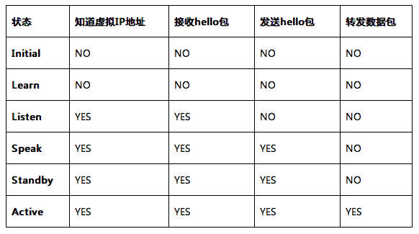
HSRP State

Slide 15
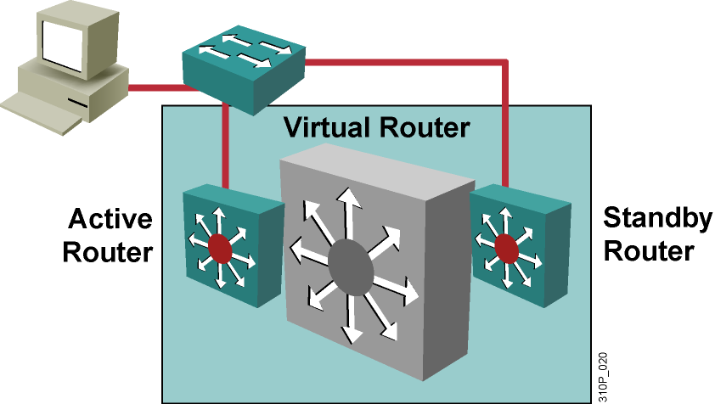
HSRP Configuration Commands
Configure
  standby 1 ip 10.1.1.1
Verify
  show running-config
  show standby

Slide 16
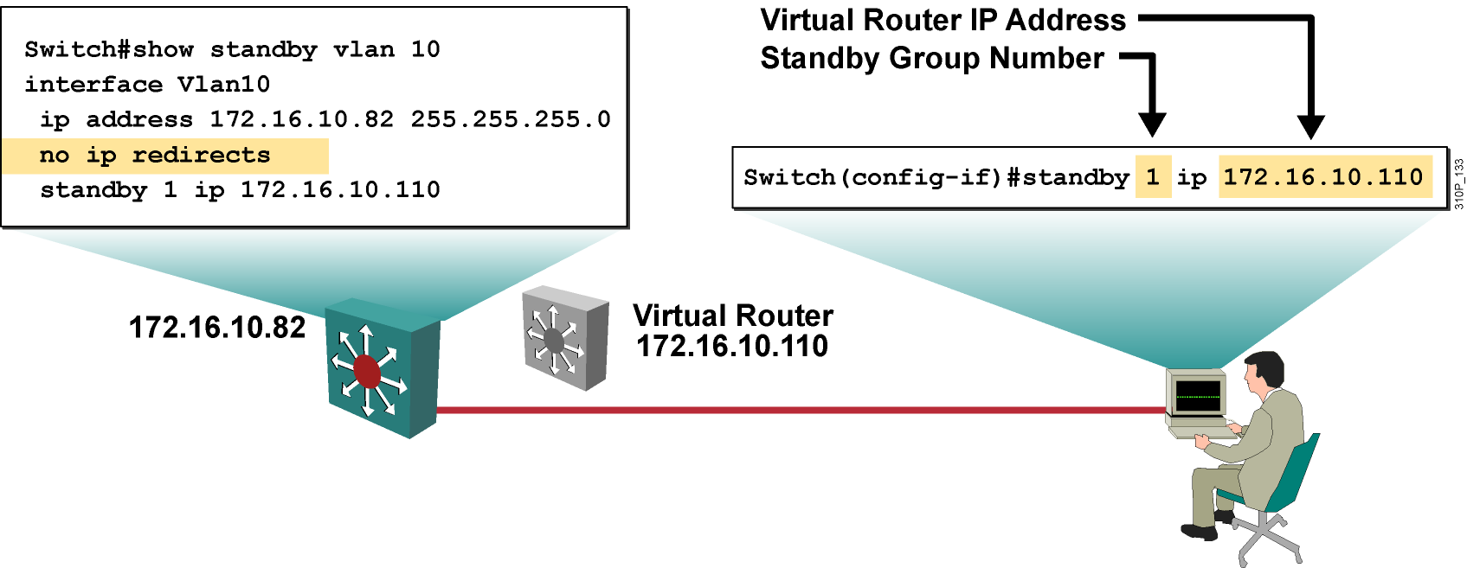
Configuring an HSRP Standby Interface
Enabling HSRP on a Cisco router interface automatically disables ICMP redirects.
Notes:
Purpose: This slide discusses the standby ip command
Emphasize:
Point out that this section, describes the basic steps required to create HSRP Standby routers. Not all HSRP commands are covered. Those command not covered are listed in this Instructor Guide but not in the Student Guide.
For a complete list of HSRP commands, refer the students to “Configuring IP Services” in the Cisco IOS Release 12.0 Network Protocols Configuration Guide.
To enable HSRP on an interface, enter the standby group number ip ip address command in interface configuration mode.
If the standby group number is not specified, all commands default to Standby Group 0 (zero).
The ip address parameter represents the address of the virtual router.
Enabling HSRP on a Cisco router interface automatically disables ICMP redirects on that interface.
To remove an interface from an HSRP group, enter the no standby group ip command.
Transition: Following discusses how to assign HSRP standby priority.

Slide 17
Displaying the Standby Brief Status
Switch#show standby brief
P indicates configured to preempt.
|
Interface Grp Prio P State Active addr Standby addr Group addr
Vl11 11 110 Active local 172.16.11.114 172.16.11.115
Notes:
Purpose: This slide discusses the command display the HSRP status of a route processor.
Emphasize:
Using the brief option displays a single line of output summarizing each standby group.
Transition: Following discusses how to enable debug in HSRP.

Slide 18
HSRP Optimization Options
These options can be configured to optimize HSRP:
  HSRP standby priority
  HSRP standby preempt
  Hello message timers
  HSRP interface tracking

Slide 19
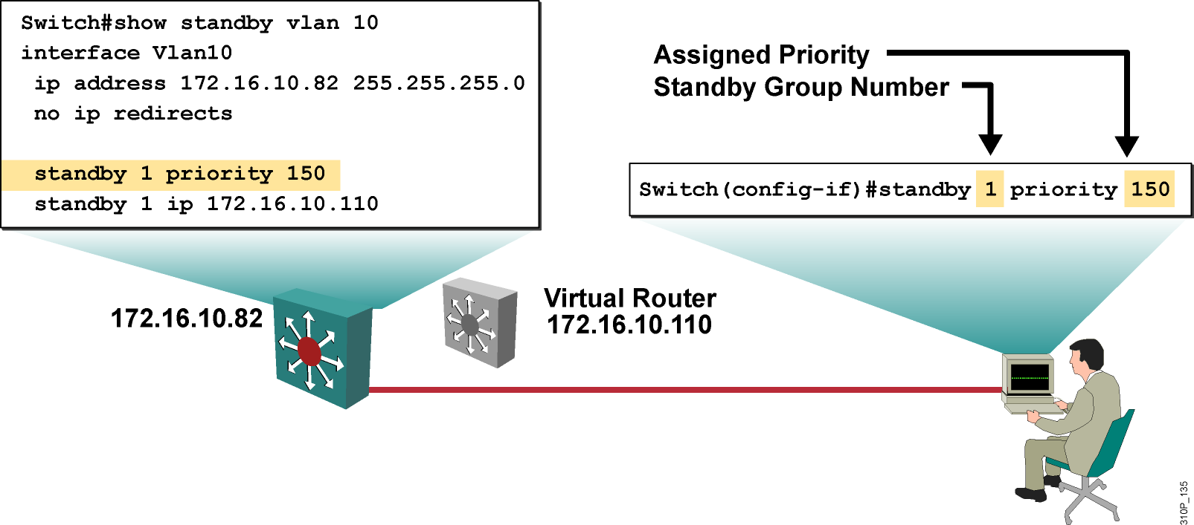
Configuring HSRP Standby Priority
  The router with the highest priority in an HSRP group becomes the active router.
  The default priority is 100.
  In the case of a tie, the router with the highest configured IP address will become active.
Notes:
Priority 0-255
Purpose: This slide discusses the standby priority command.
Emphasize:
The standby priority determines which router assumes the active router role.
If a priority is not set, the router assumes the default priority of 100.
To set the priority value of a router, enter the standby group number priority priority value command in interface configuration mode.
group number indicates the HSRP standby group. This number can be in the range of 0 to 255
priority value indicates the number that prioritizes a potential Hot Standby router. The range is 0 to 255.
The router in an HSRP group with the highest priority becomes the forwarding router.
To reinstate the default standby priority value, enter the no standby priority command.
Transition: Following discusses to guarantee a router assumes the active router role.

Slide 20
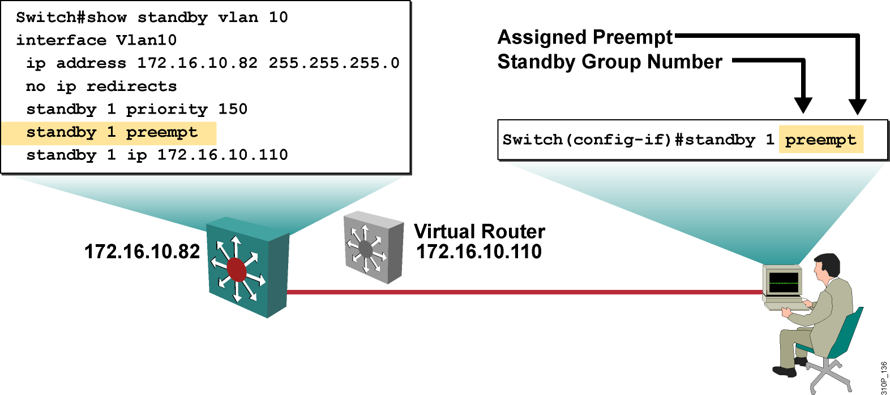
Configuring HSRP Standby Preempt
Preempt enables a router to resume the forwarding router role.
Notes:
Purpose: This slide discusses the standby preempt command.
Emphasize:
Once the active router is disabled, the standby router automatically assumes the role of the active router.
When the previous active router is re-enabled, the current active router retains the active router role even if the current active router has a lower priority than the previous active router.
To ensure the previous active router resumes the active router role, enter the standby group number preempt command in interface configuration mode.
Once the standby preempt command is issued, the interface changes to the appropriate state
To remove the interface from preemptive status, enter the no standby group preempt command.
Transition: Following introduces HSRP timers.

Slide 21
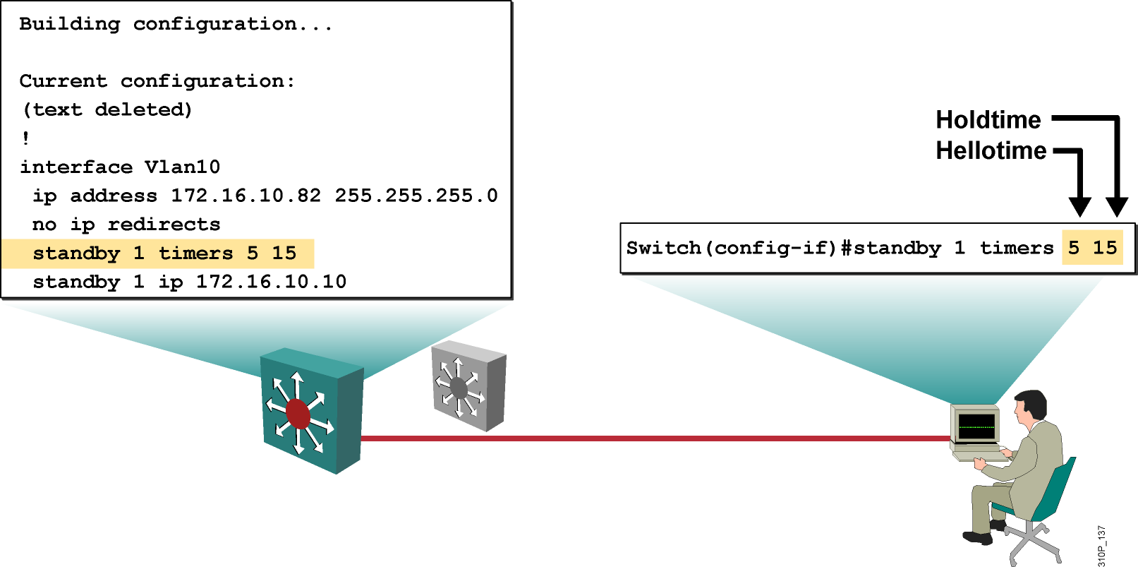
Configuring the Hello Message Timers
The holdtime parameter value should be at least three times the value of the hellotime parameter.
Notes:
Purpose: This slide discusses the standby timers command to enable IP multicasting on the router
Emphasize:
The Hello message contain a hellotime and holdtime value.
If an active router sends a Hello message, then receiving routers consider that Hello message to be valid for one holdtime.
If the standby group routers do not hear a hello message within the configured amount of time, the routers declare the active or standby router to be disabled and begin the election process for a new active or standby router.
To configure the standby timers, enter the standby group number timers hellotime holdtime command in interface configuration mode.
hellotime is the interval between hello messages in seconds. This is a value from 1 through 255. The default is 3 second.
holdtime is the interval seconds before the active or standby router is declared to be down. This is a value from 1 through 255. The default is 10 seconds.
To reinstate the default standby timer values, enter the no standby group timers command.
Transition: Following introduces HSRP tracking.

Slide 22
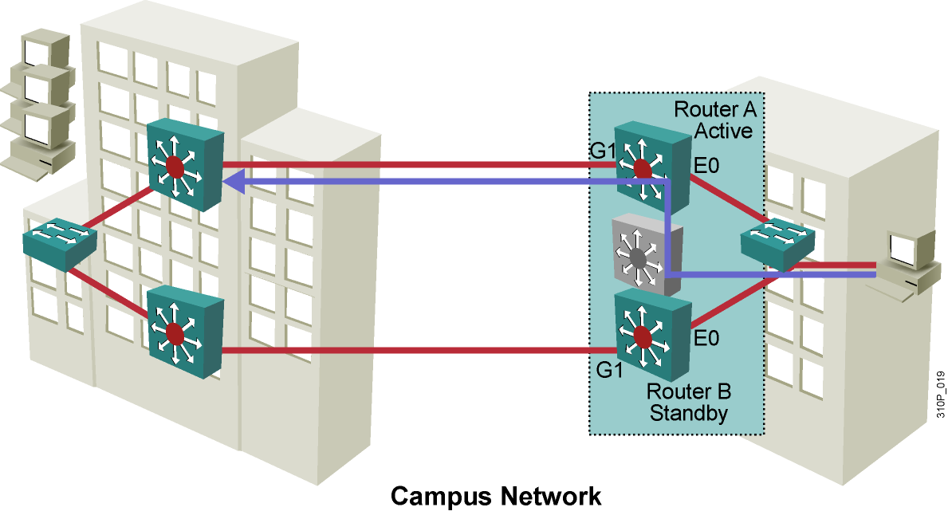
HSRP Interface Tracking
T1
T1
Notes:
Purpose: This slide illustrates what happens when a critical interface becomes disabled on the active router.
Emphasize:
In some configurations, the operational status of an interface directly affects which router needs to become the active router.
Interface tracking enables the priority of a standby group router to be automatically adjusted based on availability of the interfaces of that router.
In this example, both of the routers in an HSRP group has a different path to headquarters switches.
Router A is the Active router with a higher priority. Router A has a route to headquarters over a T1 link.
Transition: Following continues the discussion of interface tracking.

Slide 23
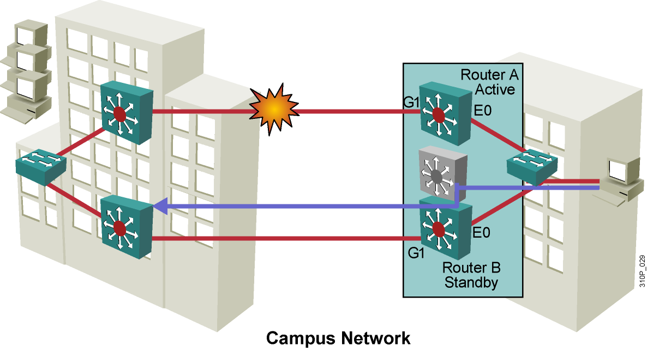
HSRP Interface Tracking (Cont.)
Notes:
Purpose: This slide illustrates what happens when a critical interface becomes disabled on the active router.
Emphasize:
The active T1 link experiences a failure. Without HSRP enable, Router A would detect the failed link and send an ICMP redirect to Router B. However, when HSRP is enable, ICMP redirects are disabled. Therefore, neither Router A nor the virtual router sends an ICMP redirect and, although the S1 interface on Router A is no longer functional, Router A still communicates hello messages out Interface E0 indicating that Router A is still the active router. Packets sent to the virtual router for forwarding the headquarters cannot be routed.
Interface tracking enables the priority of a standby group router to be automatically adjusted based on availability of the interfaces of that router. When a tracked interface becomes unavailable, the HSRP priority of the router is decreased. The HSRP tracking feature reduces the likelihood that a router with an unavailable key interface will remain the active router.
Transition: Following continues the discussion of interface tracking.

Slide 24
Configuring HSRP Tracking
Switch(config-if)#standby [group-number] track type number [interface-priority]
Configures HSRP tracking
Switch(config)#interface vlan 10
Switch(config-if)#standby 1 track GigabitEthernet 0/7 50
Switch(config-if)#standby 1 track GigabitEthernet 0/8 60
Example of HSRP tracking
Note: Preempt must be configured on all participating devices within the HSRP group.

Slide 25
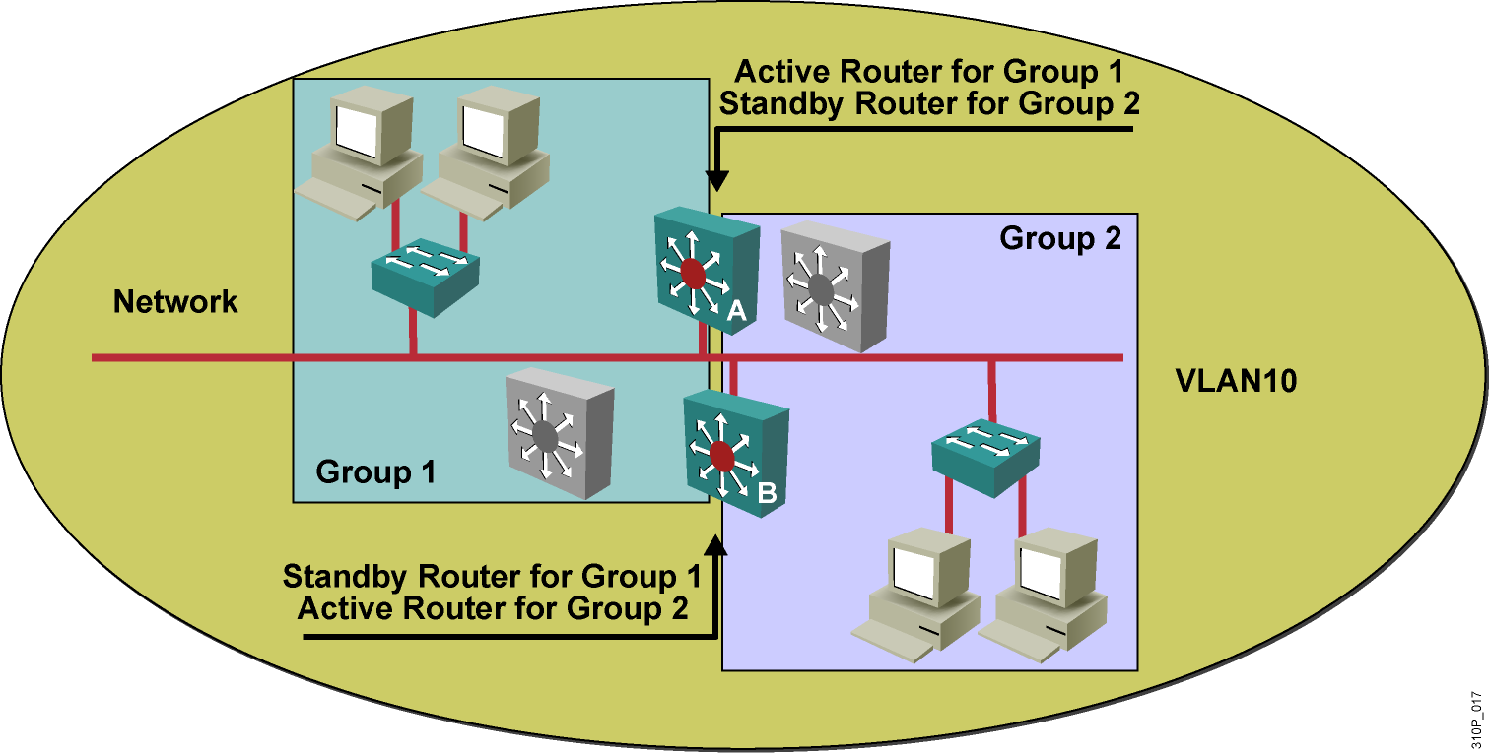
Multiple HSRP Groups
To load balance routers, assign them to multiple groups on the same subnet.
Notes:
Purpose: This slide discusses how one router may exist in multiple HSRP groups.
Emphasize:
To facilitate load sharing, a single router may be a member of multiple HSRP standby groups on a single segment. Each standby group emulates a single virtual router. There can be up to 255 standby groups on any LAN.
Increasing the number of groups in which a router participates increases the load on the router and can impact the performance of the router.
Discuss the example.
Transition: Following discusses ISL links and HSRP.

Slide 26
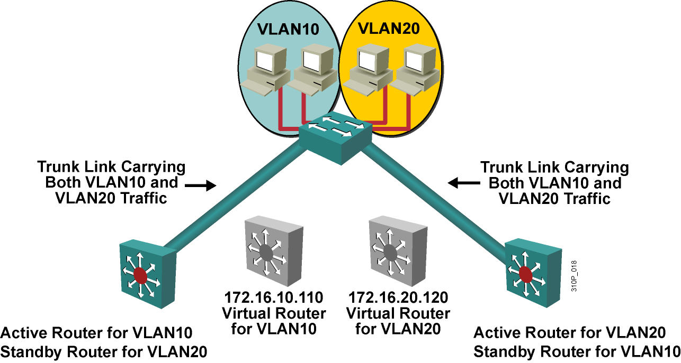
Addressing HSRP Groups Across Trunk Links
  To load balance routers and links:
    Per VLAN, configure the HSRP active router and the spanning tree root to be the same multilayer switch.
Notes:
Purpose: This slide discusses how multiple groups transmit data over a single link.
Emphasize:
Routers can simultaneously provide redundant backup and perform load sharing across different IP subnets.
For each standby group, an IP address and a single well-known MAC address with a unique group identifier is allocated to the group.
The IP address of a group is in the range of addresses belonging to the subnet in use on the LAN. However, the IP address of the group must differ from the addresses allocated as interface addresses on all routers and hosts on the LAN, including virtual IP addresses assigned to other HSRP groups.
Work through the example.
Transition: Following continues the discussion of multi-group HSRP.

Slide 27

About the HSRP Debug Command
  debug standby events
  debug standby terse(简明的)

Slide 28
Debugging HSRP
DSW111#debug standby
*Mar 4 19:08:08.918: HSRP: Vl1 Grp 1 Hello out 172.16.1.111 Active pri 150 vIP 172.16.1.113
*Mar 4 19:08:09.287: HSRP: Vl1 Grp 2 Hello in 172.16.1.112 Active pri 50 vIP 172.16.1.113
*Mar 4 19:08:09.287: HSRP: Vl1 API active virtual address 172.16.1.113 found
*Mar 4 19:08:09.891: HSRP: Vl1 API Duplicate ARP entry detected for 172.16.1.113
*Mar 4 19:08:09.891: HSRP: Vl1 Grp 1 Hello out 172.16.1.111 Active pri 150 vIP 172.16.1.113
*Mar 4 19:08:10.294: HSRP: Vl1 Grp 2 Hello in 172.16.1.112 Active pri 50 vIP 172.16.1.113
*Mar 4 19:08:10.294: HSRP: Vl1 API active virtual address 172.16.1.113 found
*Mar 4 19:08:10.294: HSRP: Vl1 API Duplicate ARP entry detected for 172.16.1.113
*Mar 4 19:08:10.294: HSRP: Vl1 Grp 1 Hello out 172.16.1.111 Active pri 150 vIP 172.16.1.113
*Mar 4 19:08:10.294: HSRP: Vl1 Grp 2 Hello in 172.16.1.112 Active pri 50 vIP 172.16.1.113
*Mar 4 19:08:10.294: HSRP: Vl1 API active virtual address 172.16.1.113 found
*Mar 4 19:08:10.898: HSRP: Vl1 API Duplicate ARP entry detected for 172.16.1.113
*Mar 4 19:08:10.898: HSRP: Vl1 Grp 1 Hello out 172.16.1.111 Active pri 150 vIP 172.16.1.113
*Mar 4 19:08:10.965: HSRP: Vl1 Grp 2 Hello in 172.16.1.112 Active pri 50 vIP 172.16.1.113
*Mar 4 19:08:11.300: HSRP: Vl1 API active virtual address 172.16.1.113 found
Example of HSRP debug showing standby group number mismatch
Notes:
V11 表示vlan 11
Purpose: This slide discusses the standby debug command.
Emphasize: HSRP supports the debug command. To enable HSRP debugging, enter the debug standby
Enabling the debug facility displays the HSRP state changes and debugging information regarding transmission and receipt of HSRP packets.
Caution the students that because debugging output is assigned high priority in the CPU process, this command can consume router processing cycles.
Other commands that are supported by HSRP.
Standby authentication assigns an eight character password to the group. This command is useful in preventing configuration errors. The default authentication string is cisco.
Standby mac-refresh alters the interval at which packets are sent to refresh the MAC cache when Hot Standby Router Protocol (HSRP) is running over FDDI.
Standby use-bia configures the Hot Standby Router Protocol (HSRP) to use the interface's burned-in address as its virtual MAC address, instead of the preassigned MAC address
Transition: The following introduces the laboratory exercise.

Slide 29



生成树原理介绍 (802.1D)
Configuring First Hop Redundancy
Protocols with VRRP and GLBP
SPOTO KMS
SPOTO IT人才培训机构 www.SPOTO.net 以伙伴关系帮助客户成功，帮助员工成功，帮助合作伙伴成功。
SPOTO IT人才培训机构 www.SPOTO.net 以伙伴关系帮助客户成功，帮助员工成功，帮助合作伙伴成功。

Slide 30
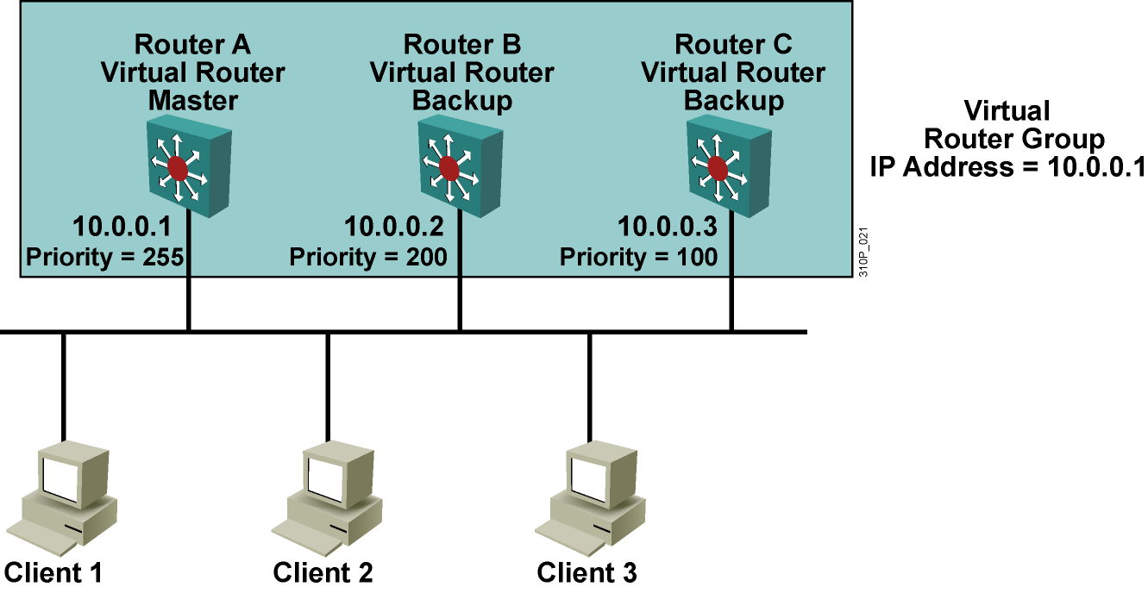
VRRP(Virtual Router Redundancy Protocol)
&VRRP是工业标准.通过224.0.0.18发送通告.
&状态:INIT->MASTER->BACKUP
&发送Hello包的时间:1s,主路由器的失效时间为:3*hello+skew time.
（skew time=（256-pri)/256 ms）这个时间是确保优先级更好的备份路由器成为新的master路由器
&HSRP和VRRP的主要区别是VRRP备用路由器不发送通告.
Notes:
如果需要和其他厂商做冗余，必须要用到VRRP协议，工业标准
最好是不用把RouerA优先级设置成255，如果RouterA需要升级或者维护，需要暂时让RouterB作为Active路由器。但是因为RouterA配置了优先级为254，这将导致RouterA一直是活跃路由器。

Slide 31
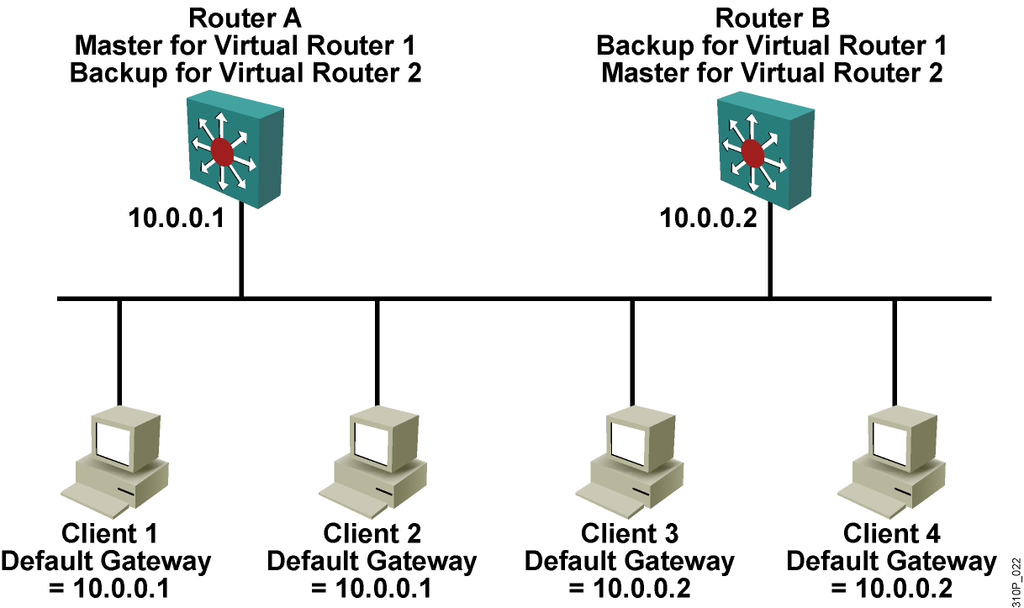
VRRP Operational Process

Slide 32
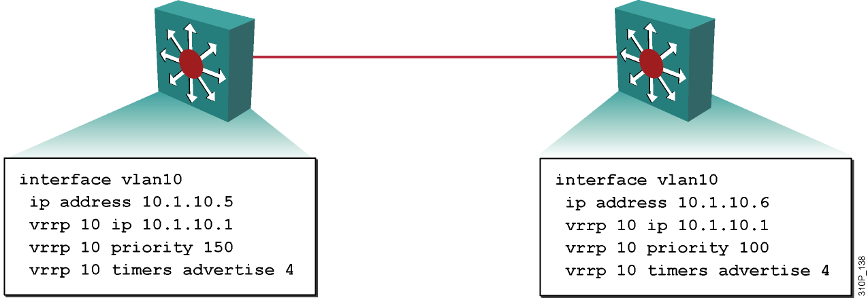
Configuring VRRP on an Interface
  Enable VRRP on an interface and display the configuration.
Notes:
HSRP:
1）cisco私有
2）6种状态
3）路由器角色：虚拟路由器、active路由器（1个)、standby路由器(1个)、other路由器
4）time：hello time=3s hold time 10s
5) 默认没有开启抢占性
6）虚拟IP地址不能为真实的IP地址
7）224.0.0.2
VRRP:
1）IEEE 工业标准
2）3种状态
3）路由器角色：虚拟路由器、master路由器、backup路由器
4）time：hello time=1s hold time=3hellotiem+skewtime
5) 默认开启抢占性
6) 虚拟IP地址可以为真实的IP地址，当某个设备的IP地址作为虚拟地址，他的优先级默认设为255
7）224.0.0.18

Slide 33
GLBP Operations
  Single virtual IP address and multiple virtual MAC addresses
  Traffic to single gateway distributed across routers
  Automatic rerouting（变更） in the event of any failure
  Full use of resources on all routers without the administrative
  burden of creating multiple groups

Slide 34
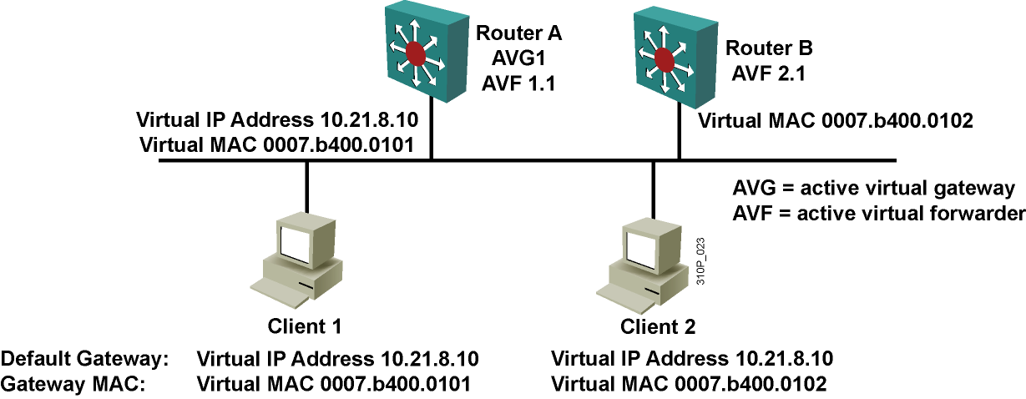
GLBP Operations（cont.）
  GLBP group members elect one AVG.
  AVG assigns a virtual MAC address to each member of the group.
  AVG replies to the ARP requests from clients with different virtual MAC addresses, thus achieving load balancing.
  Each router becomes an AVF for frames that are addressed to that virtual MAC address.
Notes:
AVG：活跃虚拟网关
AVF：活跃虚拟转发器

Slide 35
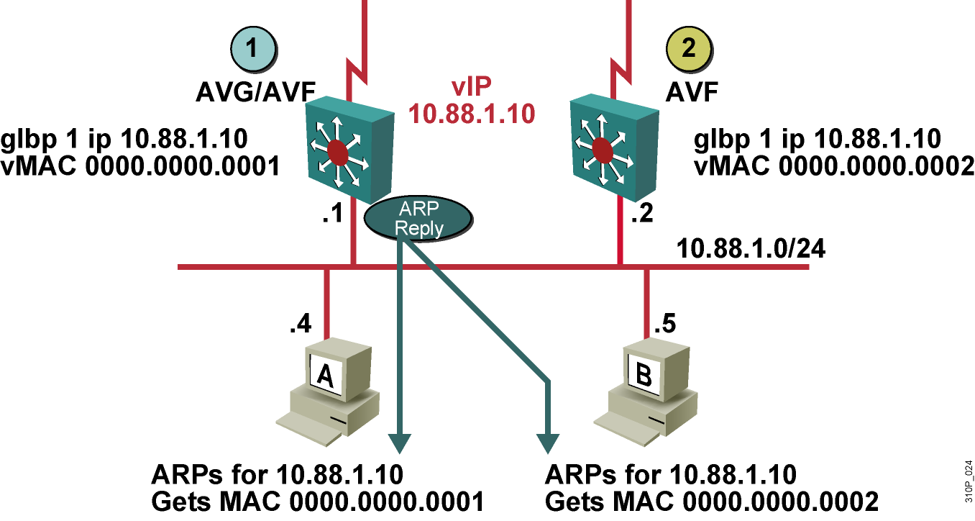
GLBP Operation

Slide 36
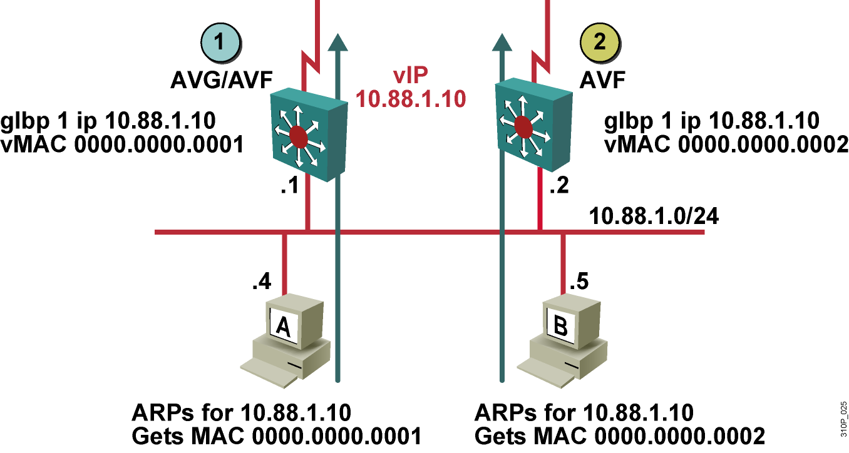
GLBP Operation (Cont.)

Slide 37
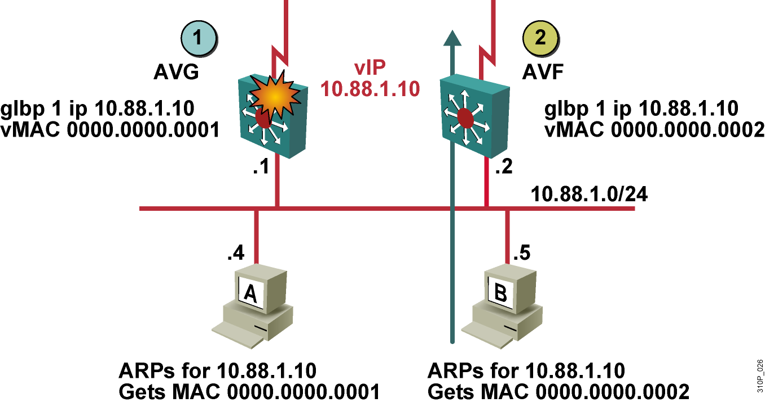
GLBP Interface Tracking

Slide 38
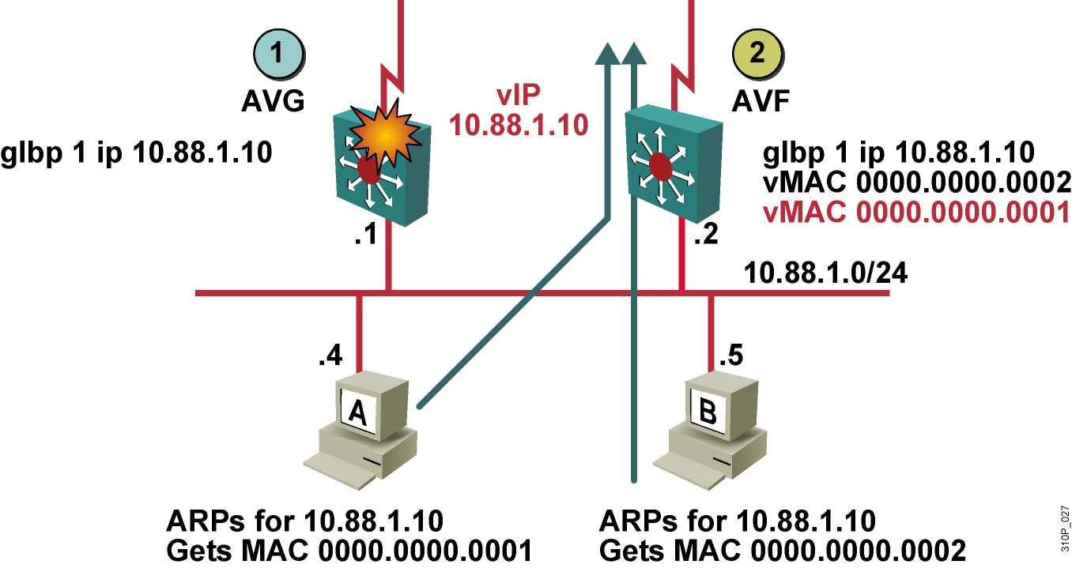
GLBP Interface Tracking (Cont.)
Notes:
当第一台AVF挂掉的时候，第二台会暂时替第一台AVF转发数据，这个时候，又有一台PC发送ARP广播请求，第二台AVF就会要求AVG在redirct time （重定向时间，600秒）之后，不要将挂掉的MAC通告给后面来的PC，以免增加第二台AVF的负担。600秒之内都是可以回应给后面的PC的。
Redirect time 600
Forward timeout 14400 4个小时后，第二台将不再替挂掉的AVF转发数据

Slide 39
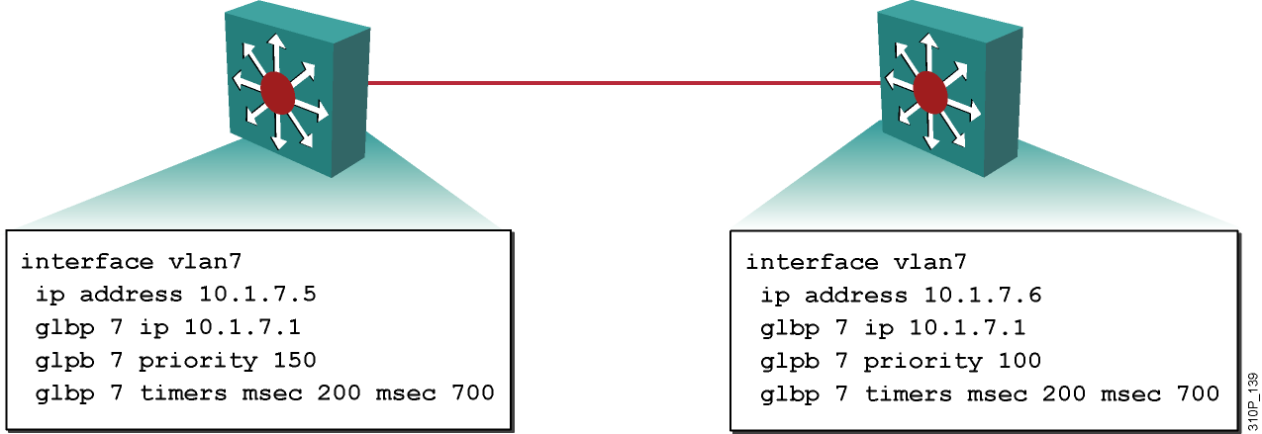
Configuring GLBP on an Interface
  Enable GLBP on an interface and display the configuration.

